Slide 1
AI-DRIVEN DEMAND FORECASTING AND WASTE MANAGEMENT SYSTEM FOR SRI LANKAN RESTAURANTS
Reducing Waste & Improving Efficiency in Sri Lankan Restaurants
Group ID: RP_25_26J_393
Date: 07 January 2026

Slide 2
Introduction to the Problem
The Challenge Facing Sri Lankan Restaurants
Current State of the Industry: | Core Problems:
Sri Lanka's restaurant industry is experiencing rapid growth but faces critical operational challenges Restaurants struggle with unpredictable supply and demand patterns Frequent stockouts lead to lost revenue and customer dissatisfaction Food surplus results in significant waste and financial losses | Manual inventory management - Restaurant owners rely on guesswork rather than data-driven decisions Unreliable supply chains - Suppliers face uncertain demand forecasts, leading to inefficient logistics Rising operational costs - Increasing food prices and supply shortages squeeze profit margins Limited technological adoption - Small restaurants lack access to advanced ERP systems
The Reality: Small-scale restaurants operate in a cycle of inefficiency, where poor forecasting leads to waste, reduced profitability, and operational stress.

Slide 3
Social and Research Impact of the Solution
Transforming Sri Lanka's Food Ecosystem
Social Impact: | Research Impact:
Food Security Enhancement - Reducing food waste contributes to better resource utilization in a developing economy Small Business Empowerment - Enabling small restaurant owners to compete with larger establishments through technology Supply Chain Resilience - Creating more predictable and efficient food distribution networks Economic Growth - Supporting SMEs in the hospitality sector, a key contributor to Sri Lanka's economy | Advancing AI in Developing Markets - Developing solutions for data-scarce environments typical in emerging economies Contextual Forecasting Innovation - Incorporating cultural events, weather patterns, and local seasonality into demand prediction Integrated Platform Development - Combining multiple business functions (forecasting, inventory, supplier management) in one solution Sustainable Business Models - Demonstrating how technology can drive both profitability and environmental responsibility
Broader Benefits:
Restaurant Owners → 15-30% waste reduction, improved profit margins
Suppliers → Better demand visibility, optimized delivery schedules
National Economy → Reduced food waste, enhanced digital transformation in SME sector

Slide 4
Previous Research & Shortcomings and Our Approach
Previous Systems:
Existing studies focus mainly on general demand forecasting, not on localized, lightweight solutions for small restaurants.
Most systems ignore supplier-side forecasting and dynamic price fluctuations.
Our novelty: Combination of four component system targeted both owner and supplier
Lightweight hybrid food demand forecaster (suitable for Sri Lankan context).
AI inventory reorder management for optimized stock control.
Ingredients demand forecaster to guide suppliers.
Price prediction & supplier recommendation engine.

Slide 5
Previous Research & Shortcomings and Our Approach
Constraints and Limitations
Requires historical sales data from restaurants (may be limited at first).
Accuracy depends on data quality and external factors like weather/events.
Initial adoption may face resistance from traditional restaurant owners.

Slide 6
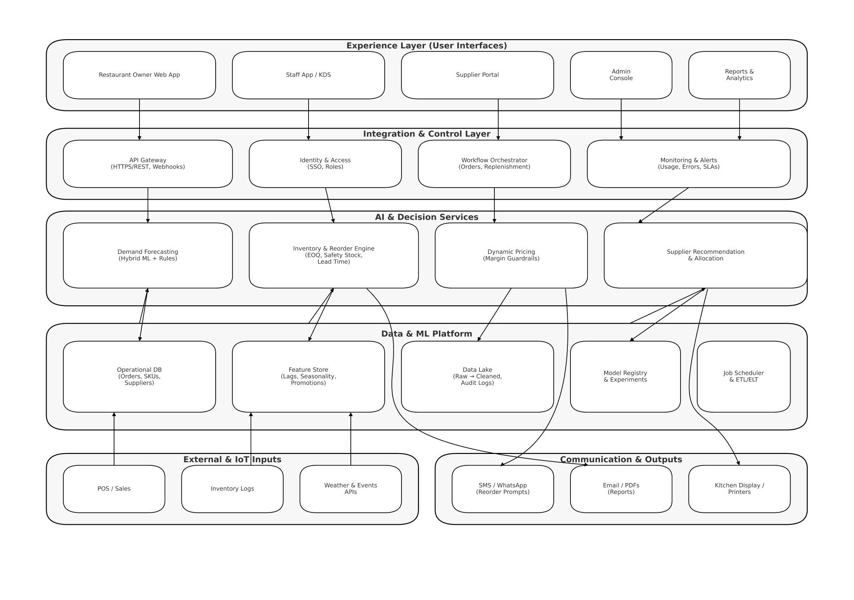
Overall System Diagram
AI-Powered Restaurant Management Platform Architecture

Slide 7




OUR TEAM
Jayathunga A.G.I.A
IT22642950
Thilakarathna W.P.N.S
IT2273846
Alawaththa A.K.A.A
IT22249470
Fernando W.G.P.N
IT22261946
Title of the Individual Component:
AI-supported inventory and reorder management system
Specialization:
Information Technology
Title of the Individual Component:
Lightweight Hybrid food demand forecaster
Specialization:
Information Technology
Title of the Individual Component:
Supplier Demand Forecasting Dashboard
Specialization:
Information Technology
Title of the Individual Component:
Food Price Prediction and Supplier Recommendation
Specialization:
Information Technology

Slide 8
Title of the Individual Component :Lightweight Hybrid food demand forecaster for local restaurants
Specialization: Information Technology

Slide 9
Lightweight Hybrid Food Demand Forecaster
Problem
Small Sri Lankan restaurants suffer from severe data scarcity, making traditional forecasting models like ARIMA or LSTM (which require years of data) ineffective
Objective
The Hybrid Approach: My solution combines XGBoost (a lightweight machine learning model) with a rule-based engine to provide accurate forecasts.
Contextual Integration: The model doesn't just look at past sales; it automatically adjusts for local factors such as weather patterns (via APIs), cultural calendars/holidays, and day-of-week effects.
The Prototype: Currently, a working backend using FastAPI and Python processes daily sales logs to generate quantity predictions for specific meal items.

Slide 10
Lightweight Hybrid Food Demand Forecaster
System Architecture
ML Forecasting Module: Baseline predictions generated using LightGBM or Facebook Prophet.
Rule-Based Adjustment Engine: A secondary layer that modifies baseline forecasts based on expert domain knowledge and external triggers.Backend: FastAPI for fast data retrieval and Python-based logic for the rule engine.
Data Sources: Integrates OpenWeatherMap API and a manually curated Sri Lankan Cultural Holiday Calendar.
End to End Data Flow
Preprocessing: Raw Data is cleaned and normalized via Python/Pandas.
Baseline Generation: ML module calculates a base forecast from temporal trends.
Contextual Overlay: Rule engine pulls real-time weather and holiday data.
Refinement: Expert rules (e.g., "IF Vesak THEN 2.0x") adjust the baseline.Output:
Final demand forecast is displayed on a mobile-friendly dashboard.

Slide 11
Lightweight Hybrid Food Demand Forecaster
AI/ML Forecasting
Lightweight Models: Focus on LightGBM and Prophet to avoid overfitting on small datasets.
Key Features:
Temporal: Day-of-week, month, and seasonal trends.
Cultural: Local holidays (e.g., Sinhala New Year, Vesak).
Meteorological: Daily temperature and precipitation.
Inventory Planning Logic
Baseline Forecasting: Predicts daily sales volume using historical patterns.
Knowledge-Driven Adjustments: Uses a formula to bridge the gap between data and reality:
Final Forecast = ML Base Prediction x Rule Based Adjustment Factor
Waste Reduction: By accurately predicting high-impact "rare events" (holidays/weather), the system prevents the over-ordering that leads to waste.

Slide 12
Lightweight Hybrid Food Demand Forecaster
Novelty and Research Contribution
Knowledge-Driven Hybridity: Moves beyond purely data-driven paradigms by "hard-coding" human expertise into a rule engine.
Proxy Data Utilization: First-of-its-kind focus on using supplier invoices as a primary data source for forecasting in un-digitized environments.
SME-Centric Design: Specifically addresses the "digital literacy barrier" by providing an interpretable, actionable tool rather than a "black box" model.
Adaptive Adjustment Algorithm
The Adjustment Engine: Handles anomalies the ML model hasn't seen enough times to learn.
Logic Example:Baseline: 100 units (calculated by LightGBM).Trigger: Cultural Calendar identifies "Vesak."Rule: IF 'Vesak' THEN multiplier = 2.0.Adjustment: Final Forecast = Rs300 x 2.0 = Rs600 units.
Validation: Uses Time-Series Cross-Validation (MAE and MAPE metrics) to ensure the adjustment improves accuracy over the baseline.

Slide 13
Lightweight Hybrid Food Demand Forecaster
Production Readiness
Economic Viability: Zero licensing fees due to an entirely open-source tech stack (Python, LightGBM, Firebase).
User Accessibility: Designed for owners with no technical expertise; outputs are simple web dashboards or exportable reports.
Data Security: All business-specific sales data is anonymized and stored with encryption in Supabase.
Scalability: The framework is built to be "pilot-ready" for any small-scale Sri Lankan retail or food service business.

Slide 14
Title of the Individual Component :AI-supported inventory and reorder management system
Specialization: Information Technology

Slide 15
AI-supported inventory and reorder management system
Problem Statement
Restaurants face demand uncertainty.
Manual planning causes overproduction, food waste, and stockouts.
Existing systems often forecast only, without operational feedback.
Objective
Build a practical production-oriented system.
Predict menu demand.
Convert demand into ingredient-level planning.
Auto-adjust safety buffers from real waste behavior.

Slide 16
AI-supported inventory and reorder management system
System Architechture
End to End Data Flow
Frontend: Next.js + React + TypeScript.
Backend: Django + DRF.
DB: PostgreSQL.
ML service: Python model loaded via joblib.
Modules: Sales, Kitchen, Forecasting, Inventory, Purchases, Suppliers.
Sales transactions stored.
Forecast model predicts menu demand.
Kitchen production planning uses predictions.
Real sold and waste captured.
Recipes map menu quantities to ingredient requirements.
Inventory suggests purchases.
Supplier order flow executes purchase.
Waste feedback updates buffer policy.

Slide 17
AI-supported inventory and reorder management system
End to End Data Flow
AI/ML Forecasting
Compute required ingredient quantity from forecast + recipe lines.Use dynamic target stock:target_stock_level = reorder_level + buffer_sizeCompute projected remaining stock and risk status (OK, LOW, OUT).Suggest purchase quantity automatically.
Feature-based demand forecasting.
Features used:
day_of_week
Month
is_weekend
lag_1
lag_7
rolling_mean_7
Recursive multi-day forecast for horizon planning.
End to End Data Flow
End-to-end integration, not standalone forecasting.
Ingredient-level adaptive buffer mechanism.
Waste-driven feedback to inventory policy.
Safe preview before applying auto-updates.

Slide 18
AI-supported inventory and reorder management system
Production Readiness
Adaptive buffer Algorithm
Multi-restaurant data scoping.Role-based access and secure APIs.Validation and error-safe processing.Daily scheduled sync command for waste and optional buffer updates.Dashboard for forecast accuracy and buffer preview.
Uses recent unsold waste over configurable lookback window.
Converts menu waste to ingredient-equivalent waste via recipe quantities.
Calculates:avg_daily_wastetarget_buffer = avg_daily_waste * buffer_daysnew_buffer = old*(1-alpha) + target*alphaSupports dry-run preview endpoint (buffer-preview).

Slide 19
Title of the Individual Component : Supplier Demand Forecasting Dashboard
Specialization: Information Technology

Slide 20
Supplier Demand Forecasting Dashboard
Problem
Small and mid-sized food companies use manual estimates or spreadsheets → causes stock outs, waste and profit losses.
suppliers only get to see their respective sales and privacy issues prevent the provision of comThere is siloing of data: plete picture of demand.
Current enterprise forecasting solutions are expensive and need organized data → not feasible in the case of small vendors.
In the absence of low-priced low-data forecasting tools → companies remain susceptible to demand fluctuations and supply chain imbalances (bullwhip effect).
Creative Solution/Prototype
This component focuses on analyzing “raw material level demand” and “current supplier inventory levels” to support supplier purchasing decisions.
Collects data from sales, inventory records, and purchase history.
The system automatically:
Calculates weekly raw material demand
Identifies low-stock situation
Estimates delivery dates
Generates purchasing proposals
A REST API exposes this information via a “supplier dashboard”, enabling real-time monitoring.
IT22249470 | Alawaththa A.K.A.A | Project ID: 25_26J_393

Slide 21
Supplier Demand Forecasting Dashboard
User Requirements
Suppliers need visibility into “raw material demand trends”
Warehouse managers need alerts for “low inventory”
Suppliers need “data-driven purchasing decisions”
The system “reduces manual tracking errors “
Supports multiple warehouses and suppliers
Design Excellence / Single Contribution
Normalized data models created for raw materials, supply inventory, sales, forecasts, and suppliers
Unique constraints implemented to maintain data integrity
Single optimized dashboard API developed to reduce front-end calls
Clean separation applied: Models, Business logic, API Layer
Implemented extensive logic for future ML-based predictive models

Slide 22

Title of the Individual Component :Food Price Prediction and Supplier Recommendation
Specialization: Information Technology

Slide 23
Food Price Prediction and Supplier Recommendation
Problem & Solution:
The Problem: Ingredient prices change every day, making it hard for restaurants to keep their food prices profitable.
The Prototype: I built a system that gets past price data from the internet to train an AI model. This model predicts if prices will go up or down.
The Results: The dashboard shows these predictions so managers can change their menu prices before they start losing money.
User Requirements:
Smart Predictions: Users get a "Confidence Score" to see how reliable the prediction is.
Better Buying: It recommends the best supplier by comparing market trends with the prices entered by the user.

Slide 24
Food Price Prediction and Supplier Recommendation
Design Excellence / Individual Contribution:
Dual Data System: My backend handles two types of data: Price history from the internet and Manual prices added by the user.
Clean Code: I kept the Database, the Business Logic, and the API separate so the system is easy to scale and fix.
Full Integration: The Next.js frontend and Django backend are fully connected. When a user enters a price, the calculator updates instantly.
User Feedback on Prototype:
Manual Entry: Users liked being able to add their own supplier prices because local prices can be different from the internet.
Easy to Use: The "Best Choice" badge for suppliers makes it very fast for a chef to decide where to buy.
Future Idea: Users suggested adding "Price Alerts" to warn them if a supplier is overcharging.

Slide 25
Thank You We welcome your questions, feedback, and suggestions.
Research Team: RP_25_26J_393 Project Duration: 12 Months

